Slide 1
Chapter 14
How to define and use your own classes

Slide 2
Applied objectives
Code the constructor for a class that has attributes and methods.
Import a class, create objects from it, access the attributes of the objects, and call the methods of the objects.
Use object composition to combine simple objects into more complex data structures.
Use encapsulation to hide the data attributes of an object.

Slide 3
Knowledge objectives
Describe a UML class diagram.
Describe the relationship between a class and an object.
In general terms, describe the identity, state, and behavior of an object.
In general terms, describe the way Python code is used to define a constructor, its attributes, and its methods.
In general terms, describe the way Python code is used to create an object from a class.
Describe the concept of object composition.
Describe the concept of encapsulation.
Distinguish between public and private attributes.
Describe the use of getter and setter methods.

Slide 4
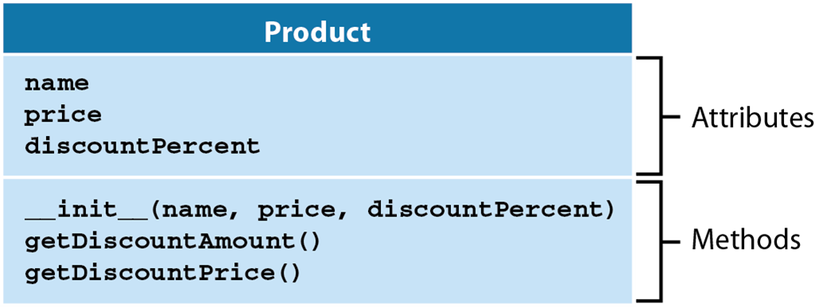
A diagram of the Product class

Slide 5
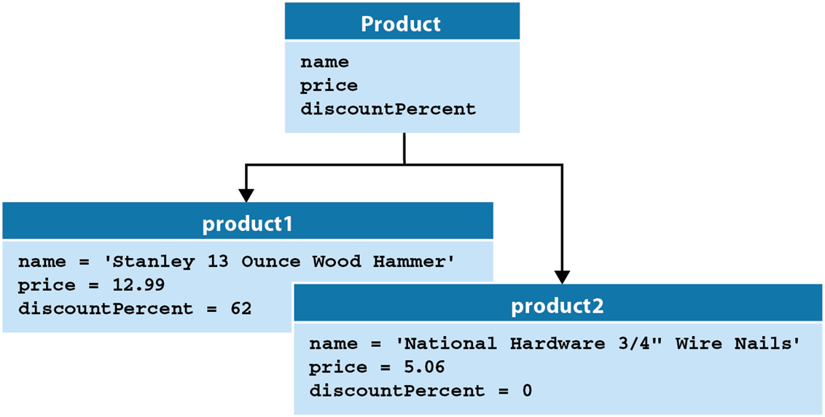
The relationship between a class and its objects

Slide 6
UML diagramming notes
UML (Unified Modeling Language) is the industry standard used to describe the classes and objects of an object-oriented application.
A UML class diagram describes the attributes and methods of one or more classes.

Slide 7
The Product class in the module named objects
class Product:
# a constructor that initializes 3 attributes
def __init__(self, name, price, discountPercent):
self.name = name # attribute 1
self.price = price # attribute 2
self.discountPercent = discountPercent
# attribute 3
# a method that uses two attributes
def getDiscountAmount(self):
return self.price * self.discountPercent / 100
# a method that calls another method
def getDiscountPrice(self):
return self.price - self.getDiscountAmount()

Slide 8
A script that creates and uses a Product object
from objects import Product
# create two product objects
product1 = Product("Stanley 13 Ounce Wood Hammer", 12.99, 62)
product2 = Product('National Hardware 3/4" Wire Nails', 5.06, 0)
# print data for product1 to console
print("PRODUCT DATA")
print("Name: {:s}".format(product1.name))
print("Price: {:.2f}".format(product1.price))
print("Discount percent: {:d}%".format(product1.discountPercent))
print("Discount amount: {:.2f}".format(
product1.getDiscountAmount()))
print("Discount price: {:.2f}".format(
product1.getDiscountPrice()))

Slide 9
The console display when the script is run
PRODUCT DATA
Name: Stanley 13 Ounce Wood Hammer
Price: 12.99
Discount percent: 62%
Discount amount: 8.05
Discount price: 4.94

Slide 10
How to import a class
The syntax
from module_name import ClassName1[, ClassName2]...
Import the Product class from the objects module
from objects import Product

Slide 11
How to create an object
The syntax
objectName = ClassName([parameters])
Create two Product objects
product1 = Product('Stanley 13 Ounce Wood Hammer',
12.99, 62)
product2 = Product('National Hardware 3/4" Wire Nails',
5.06, 0)

Slide 12
How to access the attributes of an object
The syntax
objectName.attributeName
Set an attribute
product1.discountPercent = 40
Get an attribute
percent = product1.discountPercent # percent = 40

Slide 13
How to call the methods of an object
The syntax
objectName.methodName([parameters])
Call the getDiscountAmount() method
discount = product1.getDiscountAmount()
Call the getDiscountPrice() method
salePrice = product1.getDiscountPrice()

Slide 14
The syntax for coding a constructor
def __init__(self[, parameters]): # the constructor
self.attrName1 = attrValue1 # first attribute
self.attrName2 = attrValue2 # second attribute
...

Slide 15
A constructor with no parameters
def __init__(self):
self.name = ""
self.price = 0.0
self.discountPercent = 0
Code that uses this constructor to create an object
product = Product()
Code that sets the attributes of the object
product.name = "Stanley 13 Ounce Wood Hammer"
product.price = 12.99
product.discountPercent = 62

Slide 16
A constructor with three parameters
def __init__(self, name, price, discountPercent):
self.name = name
self.price = price
self.discountPercent = discountPercent
Code that creates an object and set its attributes
product = Product("Stanley 13 Ounce Wood Hammer",
12.99, 62)

Slide 17
A constructor with default values for parameters
def __init__(self, name="", price=0.0,
discountPercent=0):
self.name = name
self.price = price
self.discountPercent = discountPercent
Code that supplies all three parameters
product = Product("Stanley 13 Ounce Wood Hammer",
12.99, 62)
Code that supplies just two parameters so the default value is used for discountPercent
product = Product(name="Stanley 13 Ounce Wood Hammer",
price=12.99)

Slide 18
The syntax for coding a method
def methodName(self[, parameters]):
statements
A method that returns a value
def getDiscountAmount(self):
discountAmount = self.price *
self.discountPercent / 100
return discountAmount
Code that calls this method
discountAmount = product.getDiscountAmount()
A more concise way to code this method
def getDiscountAmount(self):
return self.price * self.discountPercent / 100
Code that calls this method
discountAmount = product.getDiscountAmount()

Slide 19
A method that calls another method of the class
def getDiscountPrice(self):
return self.price - self.getDiscountAmount()
Code that calls this method
discountPrice = product.getDiscountPrice()

Slide 20
A method of the Product class that accepts a parameter
def getPriceStr(self, country):
priceStr = "{:.2f}".format(self.price)
if country == "US":
priceStr += " USD"
elif country == "DE":
priceStr = priceStr + " EUR"
return priceStr
Code that calls this method
print("Price: " + product.getPriceStr("US"))

Slide 21
The error that’s displayed if you forget to code the self parameter
TypeError: getPriceStr() takes 1 positional argument but 2 were given

Slide 22
The console for the Product Viewer
The Product Viewer program
PRODUCTS
1. Stanley 13 Ounce Wood Hammer
2. National Hardware 3/4" Wire Nails
3. Economy Duct Tape, 60 yds, Silver
Enter product number: 1
PRODUCT DATA
Name: Stanley 13 Ounce Wood Hammer
Price: 12.99
Discount percent: 62%
Discount amount: 8.05
Discount price: 4.94
View another product? (y/n):

Slide 23
The objects module
class Product:
def __init__(self, name, price, discountPercent):
self.name = name
self.price = price
self.discountPercent = discountPercent
def getDiscountAmount(self):
return self.price * self.discountPercent / 100
def getDiscountPrice(self):
return self.price - self.getDiscountAmount()

Slide 24
The product_viewer module (part 1)
from objects import Product
def show_products(products):
print("PRODUCTS")
for i in range(len(products)):
product = products[i]
print(str(i+1) + ". " + product.name)
print()
def show_product(product):
print("PRODUCT DATA")
print("Name: {:s}".format(
product.name))
print("Price: {:.2f}".format(
product.price))
print("Discount percent: {:d}%".format(
product.discountPercent))
print("Discount amount: {:.2f}".format(
product.getDiscountAmount()))
print("Discount price: {:.2f}".format(
product.getDiscountPrice())
print()

Slide 25
The product_viewer module (part 2)
def main():
print("The Product Viewer program")
print()
# a tuple of Product objects
products = (Product("Stanley 13 Ounce Wood Hammer",
12.99, 62),
Product('National Hardware 3/4" Wire Nails',
5.06, 0),
Product("Economy Duct Tape, 60 yds, Silver",
7.24, 0))
show_products(products)

Slide 26
The product_viewer module (part 3)
while True:
number = int(input("Enter product number: "))
print()
product = products[number-1]
show_product(product)
choice = input("View another product? (y/n): ")
print()
if choice != "y":
print("Bye!")
break
if __name__ == "__main__":
main()

Slide 27
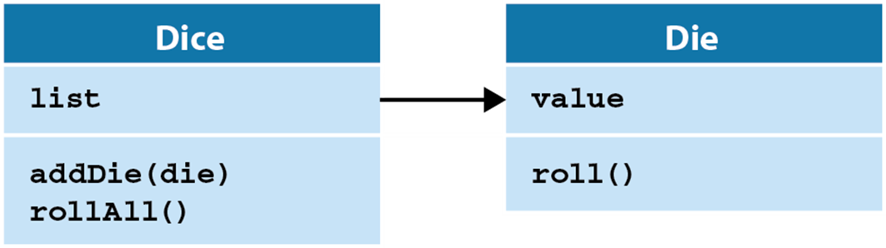
A UML diagram for two classes that use composition

Slide 28
The dice module
import random
class Die:
def __init__(self):
self.value = 1
def roll(self):
self.value = random.randrange(1, 7)
class Dice:
def __init__(self):
self.list = []
def addDie(self, die):
self.list.append(die)
def rollAll(self):
for die in self.list:
die.roll()

Slide 29
The console for the Dice Roller program
The Dice Roller program
Enter the number of dice to roll: 5
YOUR ROLL: 1 5 1 2 6
Roll again? (y/n): y
YOUR ROLL: 1 1 4 3 4
Roll again? (y/n): y
YOUR ROLL: 5 4 6 2 2
Roll again? (y/n): n
Bye!

Slide 30
The dice_roller module (part 1)
from dice import Dice, Die
def main():
print("The Dice Roller program")
print()
# get number of dice from user
count = int(input("Enter the number of dice to roll: "))
# Dice object and add Die objects to it
dice = Dice()
for i in range(count):
die = Die()
dice.addDie(die)

Slide 31
The dice_roller module (part 2)
while True:
# roll the dice
dice.rollAll()
print("YOUR ROLL: ", end="")
for die in dice.list:
print(die.value, end=" ")
print("\n")
choice = input("Roll again? (y/n): ")
if choice != "y":
print("Bye!")
break
if __name__ == "__main__":
main()

Slide 32
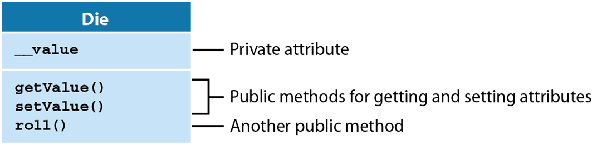
A Die class that uses methods to provide encapsulation
UML diagramming note
The double underscores (__) identify the attributes that are private.

Slide 33
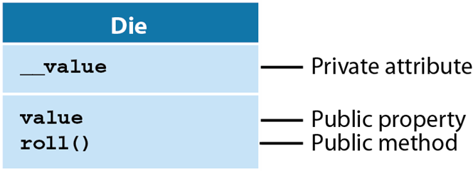
A Die class that uses properties to provide encapsulation

Slide 34
The Die class with a public attribute named value
class Die:
def __init__(self):
self.value = 1
def roll(self):
self.value = random.randrange(1, 7)
Code that directly sets and gets the public attribute
die = Die()
die.value = 10 # illegal value!
print("Die:", die.value)
The message that’s displayed on the console
Die: 10

Slide 35
The Die class with a private attribute named __value
class Die:
def __init__(self):
self.__value = 1
def getValue(self):
return self.__value
def roll(self):
self.__value = random.randrange(1, 7)
Code that attempts to directly access a private attribute
die = Die()
die.__value = 10
print("Die:", die.getValue())
The message that’s displayed on the console
Die: 1
Code that indirectly sets and gets the private attribute
die = Die()
die.roll()
print("Die:", die.getValue())

Slide 36
The Die class with methods that access a private attribute
class Die:
def __init__(self):
self.__value = 1
def getValue(self):
return self.__value
def setValue(self, value):
if value < 1 or value > 6:
raise ValueError(
"Die value must be from 1 to 6.")
else:
self.__value = value
def roll(self):
self.__value = random.randrange(1, 7)

Slide 37
Code that uses the getter and setter methods
die = Die()
die.setValue(6)
print("Die:", die.getValue())
The message that’s displayed on the console
Die: 6

Slide 38
Code that attempts to use the setValue() method to set invalid data
die = Die()
die.setValue(-1)
The error message that’s displayed on the console
ValueError: Die value must be from 1 to 6.

Slide 39
Two annotations for getting and setting properties
@property
@propertyName.setter

Slide 40
A Die class that uses a property to access a private attribute
class Die:
def __init__(self):
self.__value = 1
@property
def value(self):
return self.__value
@value.setter
def value(self, value):
if value < 1 or value > 6:
raise ValueError(
"Die value must be from 1 to 6.")
else:
self.__value = value

Slide 41
Code that uses the value property to get and set data
die = Die()
die.value = 6
print("Die:", die.value)
The message that’s displayed on the console
Die: 6

Slide 42
Code that attempts to use the value property to set invalid data
die = Die()
die.value = -1
The error message that’s displayed on the console
ValueError: Die value must be from 1 to 6.

Slide 43
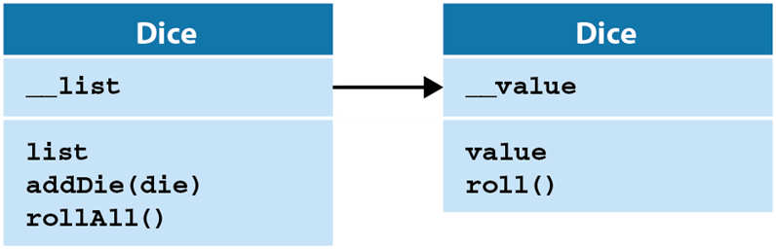
A UML diagram for two classes that use encapsulation

Slide 44
The dice module (part 1)
import random
class Die:
def __init__(self):
self.__value = 1
@property # read-only!
def value(self):
return self.__value
def roll(self):
self.__value = random.randrange(1, 7)

Slide 45
The dice module (part 2)
class Dice:
def __init__(self):
self.__list = []
@property # read-only
def list(self):
dice_tuple = tuple(self.__list)
return dice_tuple
def addDie(self, die):
self.__list.append(die)
def rollAll(self):
for die in self.__list:
die.roll()

Slide 46
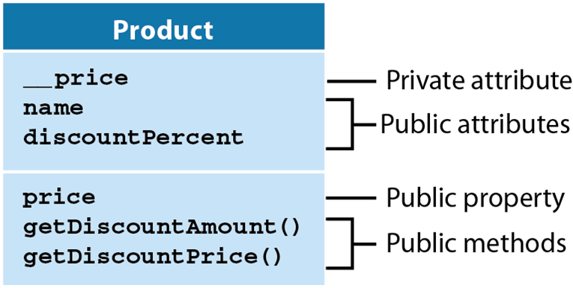
A UML diagram for a Product class that uses some encapsulation

Slide 47
The code for the Product class (part 1)
class Product:
def __init__(self, name="", price=0.0,
discountPercent=0):
self.name = name
self.price = price # passes param to setter
self.discountPercent = discountPercent
@property
def price(self):
return self.__price
@price.setter
def price(self, price):
if price < 0:
raise ValueError(
"Price can't be less than 0")
else:
self.__price = price

Slide 48
The code for the Product class (part 2)
def getDiscountAmount(self):
return self.price * self.discountPercent / 100
def getDiscountPrice(self):
return self.price - self.getDiscountAmount()

Slide 49
Code that attempts to use the price property to set invalid data
product = Product()
product.price = -11.50
Code that attempts to use the constructor to set invalid data
product = Product("Hammer", -11.50)
The error message that’s displayed on the console
ValueError: Price can't be less than 0

Slide 50
The console for the Pig Dice game
Let's Play PIG!
* See how many turns it takes you to get to 20.
* Turn ends when you hold or roll a 1.
* If you roll a 1, you lose all points for the turn.
* If you hold, you save all points for the turn.
TURN 1
Roll or hold? (r/h): r
Die: 5
Roll or hold? (r/h): r
Die: 4
Roll or hold? (r/h): r
Die: 5
Roll or hold? (r/h): h
Score for turn: 14
Total score: 14
TURN 2
Roll or hold? (r/h): r
Die: 6
Roll or hold? (r/h): h
Score for turn: 6
Total score: 20
You finished in 2 turns!
Play again? (y/n):

Slide 51
The game module
from dice import Die
class Game:
def __init__(self):
self.turn = 1
self.score = 0
self.scoreThisTurn = 0
self.isTurnOver = False
self.isGameOver = False
self.die = Die()

Slide 52
The pig_dice module (part 1)
from game import Game
def display_welcome():
print("Let's Play PIG!")
print()
print("* See how many turns it takes you to get to 20.")
print("* Turn ends when you hold or roll a 1.")
print("* If you roll a 1, you lose all points for the turn.")
print("* If you hold, you save all points for the turn.")
print()

Slide 53
The pig_dice module (part 2)
def play_game():
game = Game()
while not game.isGameOver:
take_turn(game)
def take_turn(game):
print("TURN", game.turn)
game.scoreThisTurn = 0
game.isTurnOver = False
while not game.isTurnOver:
choice = input("Roll or hold? (r/h): ")
if choice == "r":
roll_die(game)
elif choice == "h":
hold_turn(game)
else:
print("Invalid choice. Try again.")

Slide 54
The pig_dice module (part 3)
def roll_die(game):
game.die.roll()
print("Die:", game.die.value)
if game.die.value == 1:
game.scoreThisTurn = 0
game.turn += 1
game.isTurnOver = True
print("Turn over. No score.\n")
else:
game.scoreThisTurn += game.die.value
def hold_turn(game):
game.score += game.scoreThisTurn
game.isTurnOver = True
print("Score for turn:", game.scoreThisTurn)
print("Total score:", game.score, "\n")
if game.score >= 20:
game.isGameOver = True
print("You finished in", game.turn, "turns!")
else:
game.turn += 1

Slide 55
The pig_dice module (part 4)
def main():
display_welcome()
while True:
play_game()
choice = input("Play again? (y/n): ")
print()
if choice != "y":
print("Bye!")
break
# if started as the main module, call the main function
if __name__ == "__main__":
main()

